Slide 1
Exceptions
Error in Python can be of two types i.e. Syntax errors and Exceptions.
Errors are the problems in a program due to which the program will stop the execution.
Exceptions are raised when the program is syntactically correct but the code resulted in an error. This error does not stop the execution of the program, however, it changes the normal flow of the program.
When these exceptions occur, the Python interpreter stops the current process and passes it to the calling process until it is handled. If not handled, the program will crash.
For example, let us consider a program where we have a function A that calls function B, which in turn calls function C. If an exception occurs in function C but is not handled in C, the exception passes to B and then to A.

Slide 2
Some of the common Exception Errors are :
IOError : if the file can’t be opened
KeyboardInterrupt : when an unrequired key is pressed by the user
ValueError : when built-in function receives a wrong argument
EOFError : if End-Of-File is hit without reading any data
ImportError : if it is unable to find the module

Slide 3
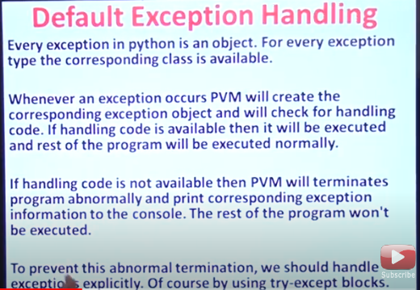

Slide 4
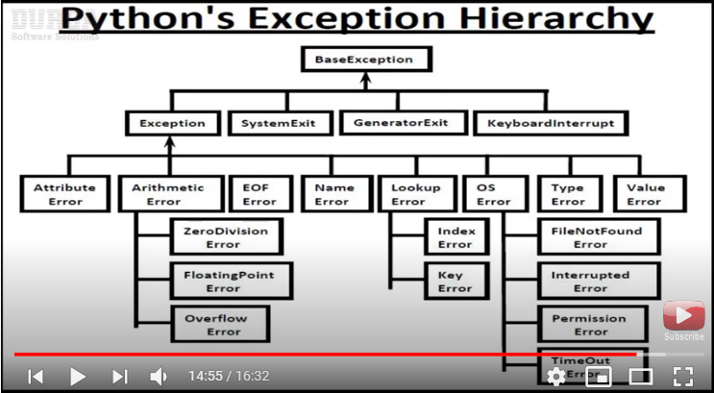

Slide 5
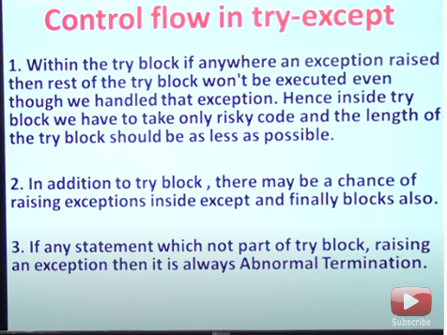

Slide 6
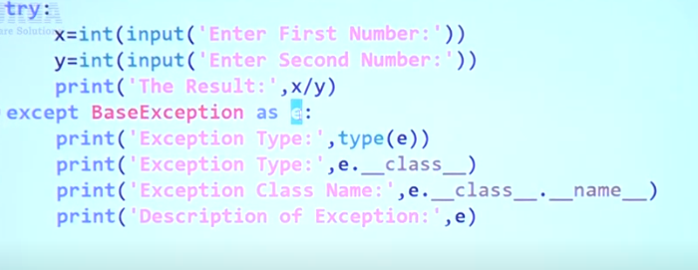

Slide 7
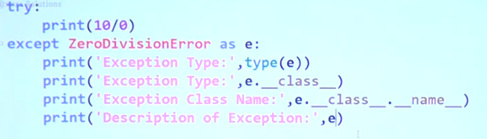

Slide 8
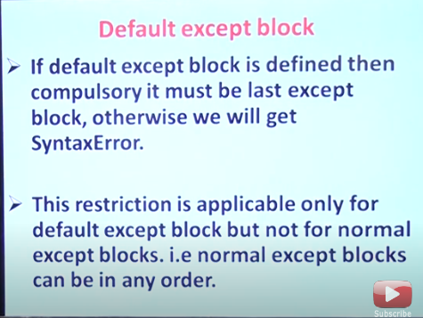

Slide 9
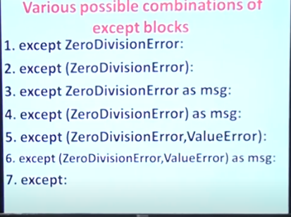

Slide 10
try-except block
Exception is the base class for all the exceptions in Python.
The critical operation which can raise an exception is placed inside the try clause. The code that handles the exceptions is written in the except clause.
In python, you can also use else clause on the try-except block which must be present after all the except clauses. The code enters the else block only if the try clause does not raise an exception.
Python provides a keyword finally, which is always executed after try and except blocks. The finally block always executes after normal termination of try block or after try block terminates due to some exception.

Slide 11
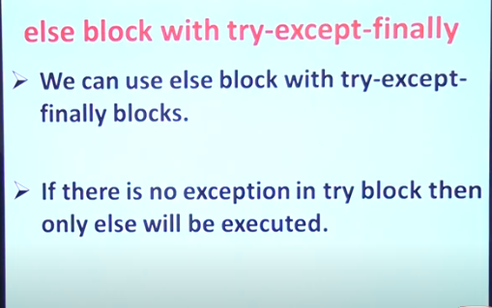

Slide 12
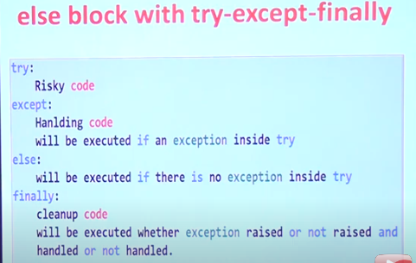

Slide 13
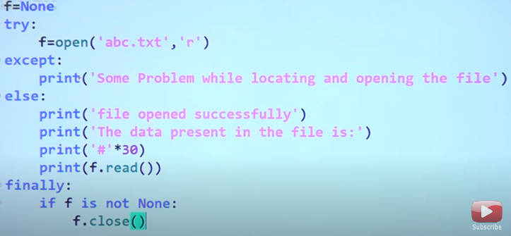

Slide 14
Raising Exception
The raise statement allows the programmer to force a specific exception to occur. The sole argument in raise indicates the exception to be raised. This must be either an exception instance or an exception class (a class that derives from Exception).

Slide 15
Programmers may name their own exceptions by creating a new exception class.
Exceptions need to be derived from the Exception class, either directly or indirectly.
Although not mandatory, most of the exceptions are named as names that end in “Error” similar to naming of the standard exceptions in python.

